Slide 1

SALES FORCASTING FOR ROSSMAN STORES
ADTA 5340& 4340 Group 8
Vikram Batchu
Joshua Brady
Matthew Flores
Matthew Myers

Slide 2
Data selection and preprocessing
Our team utilized Kaggle's "Rossmann Store Sales" dataset
Imported train.csv, test.csv, store.csv
Explored with .head(), .info(), .describe()
Data merging
Merged train_df with store_df on the store key to create merged_df
Merged test_df with store_df
Date Feature Engineering
Extracted features from Date for models to build correlations from
Target Variable Transformation
Created LogSales to avoid log(0) errors and normalize distribution of sales
Categorical Encoding
Converted StateHoliday and StoreType to categorical with dummy variables for models to detect and utilize information

Slide 3
Data preprocessing
Handling of Competition and Promo2 Variables
Cleaning of missing values
Identified to the model clear signals for competition and promotion activity
Checks for missing values, outliers and duplicates
Confirm no critical values missing before modeling
Confirm preprocessing steps worked as expected
No duplicates that could lead to incorrect training were found
Scaling and Normalization
Applied StandardScaler() to numeric columns
Attempted to ensure features were on similar range for model performance improvement

Slide 4
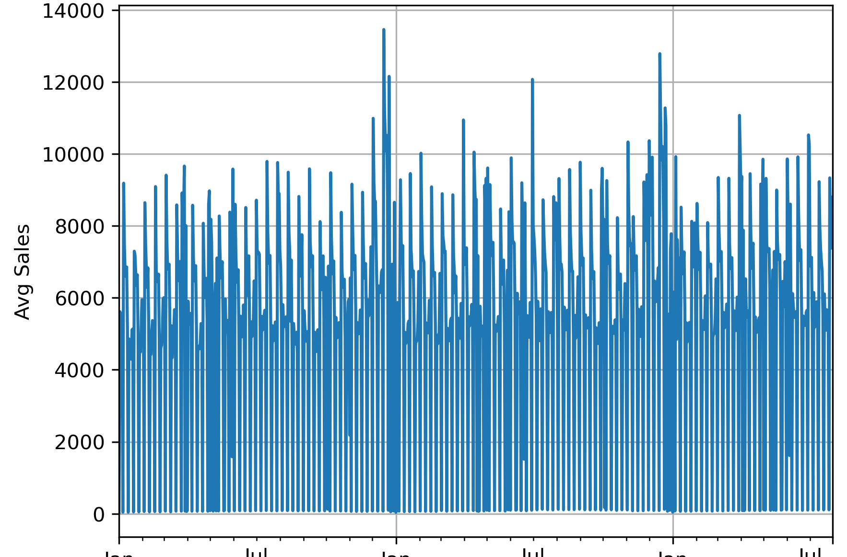
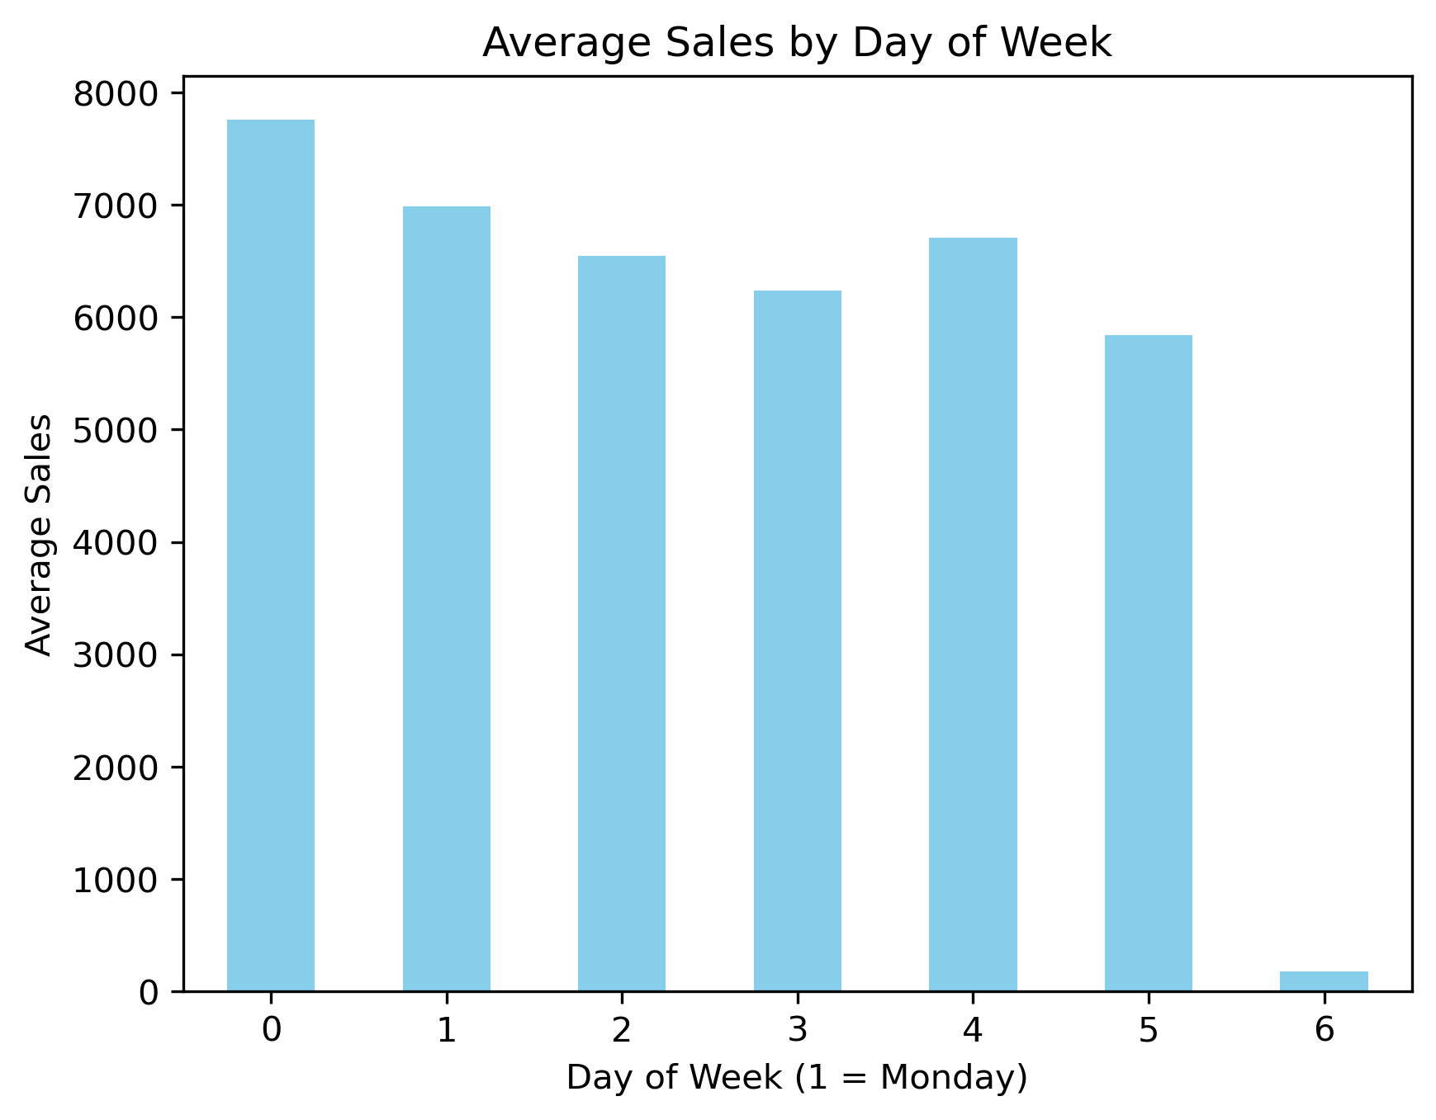
EDA: When Are sales highest?
~ 200,000 customers across all stores daily
Peak in 4th quarter around December
Week
Higher earlier in week beginning with Monday
Day
Year

Slide 5
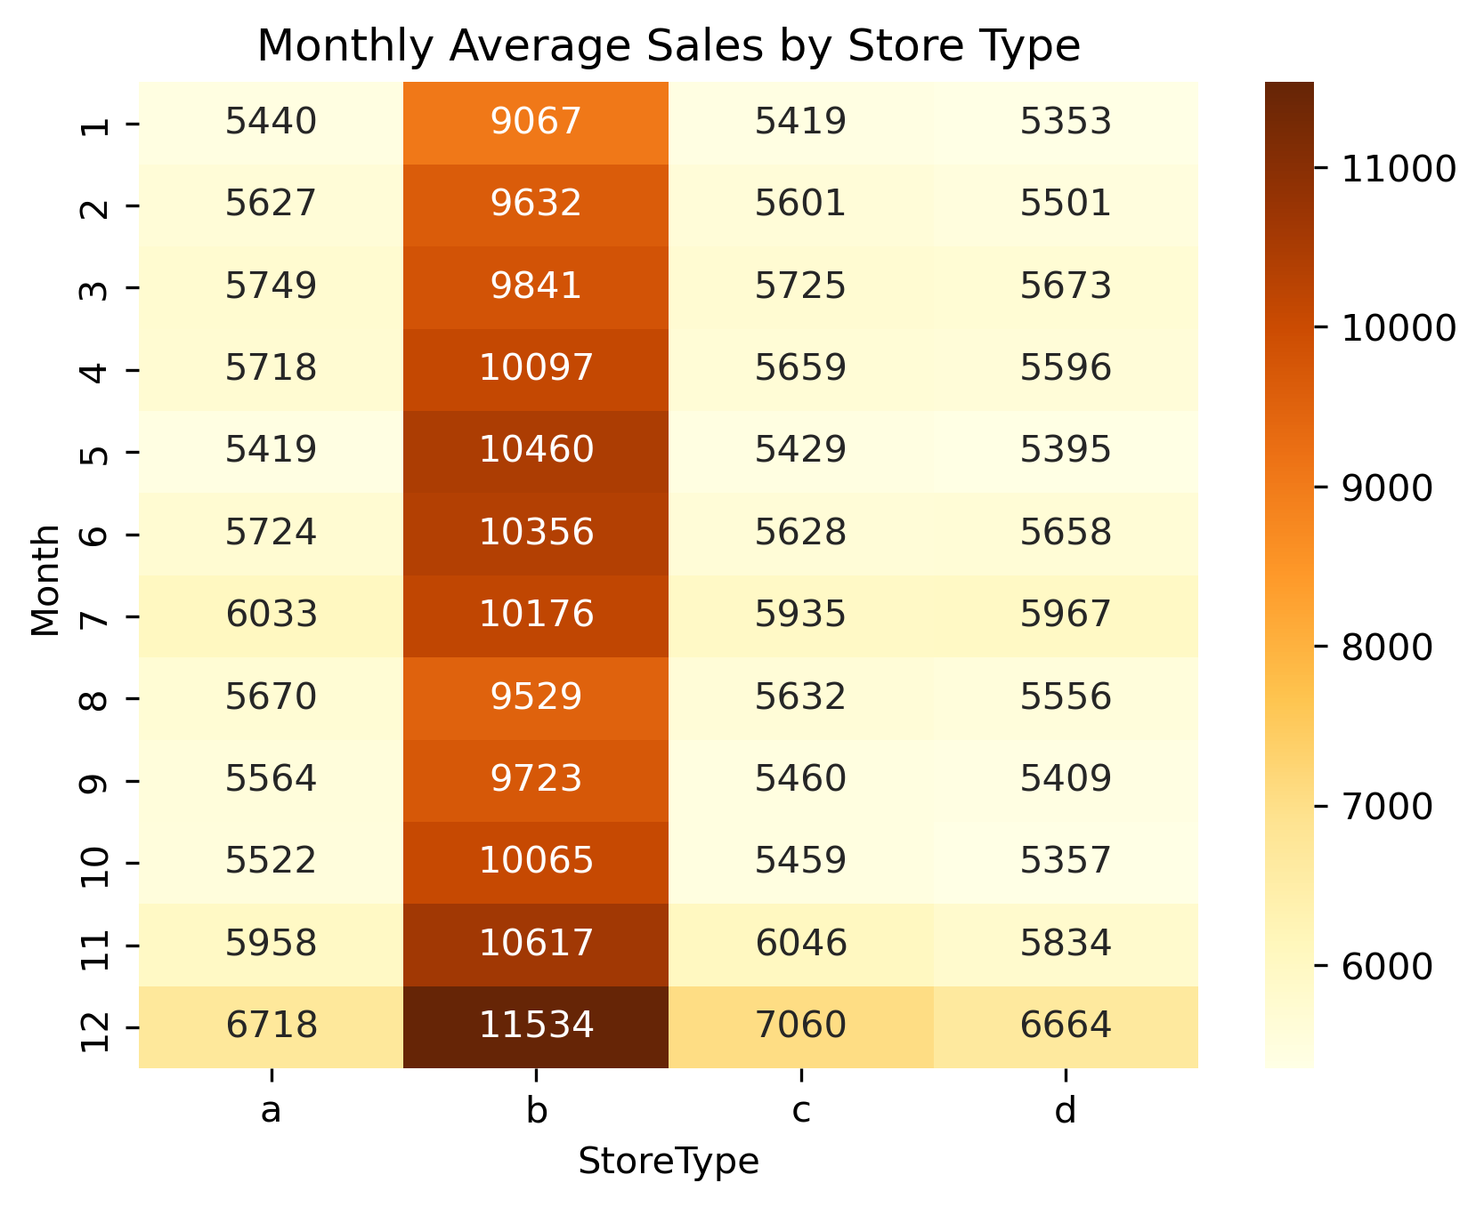
EDA: Where are sales Highest?
Stores type 'B'
Stores running only first Promo
Stores with competition within 500m

Slide 6
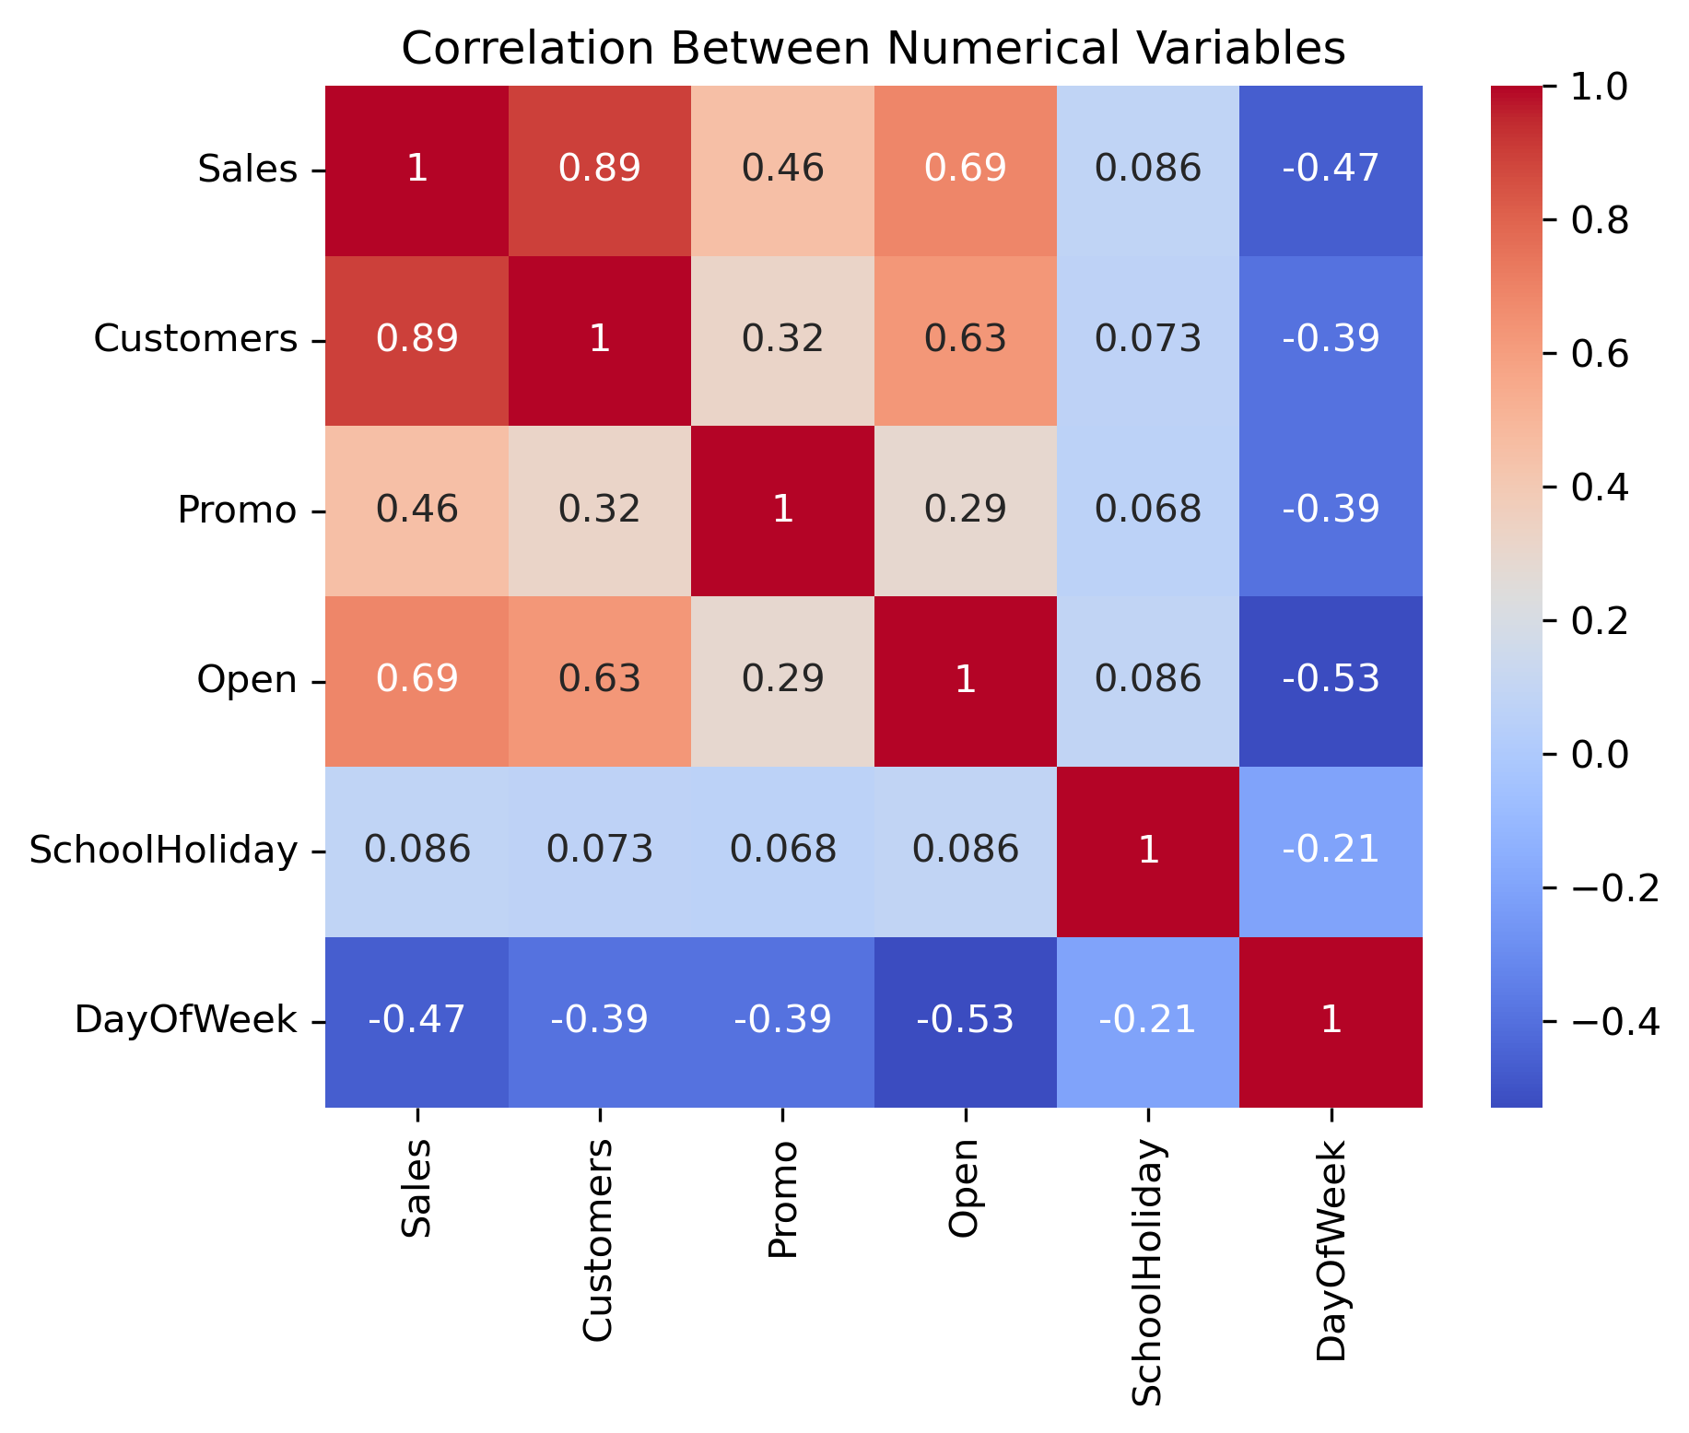
EDA: What Other Factors are driving Sales?
Stores that are open more often and see more customers
Promo2 drives sales; however, weaker performing compared to first promotion and combo
Weak positive correlation between sales and school holidays

Slide 7
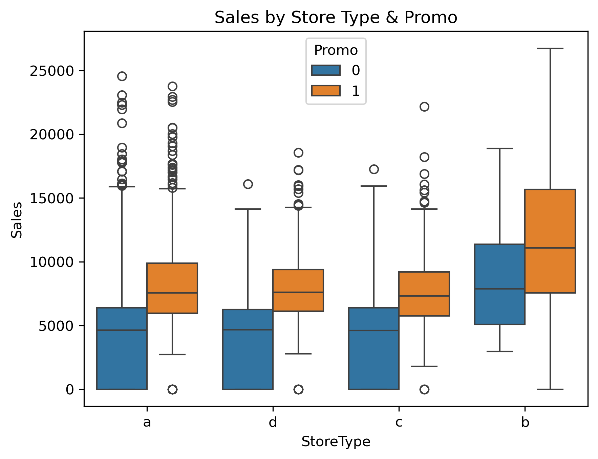
EDA: Where are Sales Weakest?
No competition 3-6km
Dropoff on Sunday at end of week
Stores running no promotion
First quarter at beginning of year
Store type 'D'

Slide 8
Modeling
Next-Quarter Sales Forecast & Key Drivers
Predict daily sales for the next quarter using historic Rossmann data
Identify factors that influence the sales the most
Provide actionable recommendations to increase sales over time

Slide 9
Data & Model Pipeline
Data
Feature Eng.
Train/Test Split
XGBoost
Ridge Regression
Insights
Chosen Data Features
Calendar: Captures normal seasonality
Promotions: Measures direct lift form marketing campaigns and Promo2's month-specific schedule
Competitions: Nearby rivals can hurt or, per EDA, sometimes boost traffic.
Store descriptors: Per EDA store layout B had a moderate positive linear correlation with sales.
Recent Demand: Recent sales can often be indicative of changing trends or surges.
Holidays: Foot-traffic changes on public-school breaks and federal holidays.

Slide 10
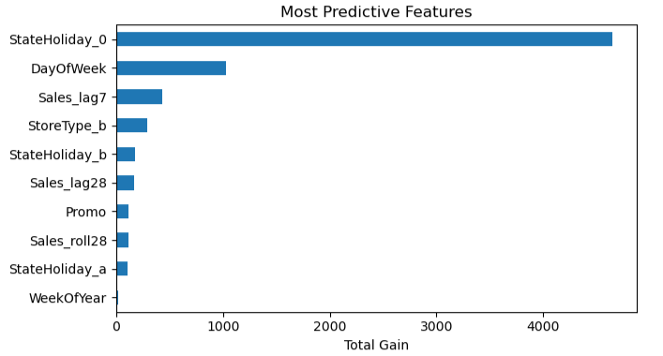
Features driving sales
Normal vs. holiday days (StateHoliday_0): account for most sales variance
Day-of-week: pattern shows early-week peaks and Sunday troughs
Last-week momentum (Sales_lag7): is the strongest short-term predictor
Store Type B: locations consistently outperform other formats
Bridge-day holidays (StateHoliday_b): behave differently from full holidays
Monthly trend anchors (Sales_lag28, Sales_roll28): capture broader seasonality
Promotions (Promo): deliver immediate, predictable lift
These features explain > 80 % of model gain and highlight where inventory, staffing, and promo budgets should focus.

Slide 11
Accuracy
Definitions
Model | RMSE (USD) | MAPE %
Naïve (lag-7) | $7,096 | ≈25%
Ridge Regression | $1,732 | 15.65%
XGBoost | $901 | 9.91%
Naïve (lag-7): A Forecast that "copies" sales from exactly one week ago.
Ridge Regression: Linear model with a small weight penalty to avoid over-fitting.
XGBoost: Ensemble of boosted decision trees- captures non-linear patterns, high accuracy.
RMSE: Avg. Dollar error (big misses weighted more). Lower = better.
MAPE %: Avg. Percent error vs. Actual sales. Lower = better.

Slide 12

Model gaps & improvement ideas
Zero-sales days & holiday closures
Current model fills or clips; add specialized “closed-day” classifier to eliminate noise.
Coarse competition metric
"Distance in m" ignores foot-traffic; enrich with census foot-fall or mall-tenant mix.
Weather & macro factors missing
Temperature and CPI can shift demand ±5%; pull open-weather API + macro series.
Model drift over time
Consumer habits change; schedule monthly retraining and rolling validation.
Stock-outs not captured
Sales equaling 0 may be out-of-stock, not zero demand; integrate POS inventory flags.

Slide 13

Insights
Promotions & Timing:
Promotions drive a significant sales increase.
Mondays and Q4 (holiday season) are peak periods.
Store & Product Strategy:
Store Type B consistently outperforms.
Assortment Type C (wider range) leads to higher revenue.
Customer Behavior Patterns:
High sales at the beginning of the week.
Sundays show minimal or no sales.

Slide 14
Insights
Foot Traffic Distribution:
Most stores receive moderate traffic (600–800 customers/day).
A few stores are high-traffic outliers and deserve attention.
Competitive Positioning:
Stores near competitors (within 500m) often perform better.
Data Quality Concerns:
Open stores with zero sales suggest data inconsistencies.

Slide 15

Business recommendations
Promotions & Launch Timing:
Focus promotional efforts on weekdays to take advantage of higher customer activity.
Introduce new products early in the week for better traction.
Store Optimization:
Replicate Store Type B best practices across formats.
Expand Assortment Type C to more locations to improve variety..
Location Strategy:
Invest in high-traffic stores to maximize ROI.
Target competitor-dense areas for new openings..
Sunday & Data Optimization:
Reduce or revise Sunday operations in low-performing stores..
Audit and resolve data inconsistencies to improve forecast accuracy..

Slide 16

ROLES
Vikram Batchu ​- Analysis, Business Insights & Recommendations
Joshua Brady ​- Analysis, Data Prep and Preprocessing
Matthew Flores - ​Analysis, EDA
Matthew Myers – Analysis, Modeling

